Slide 1
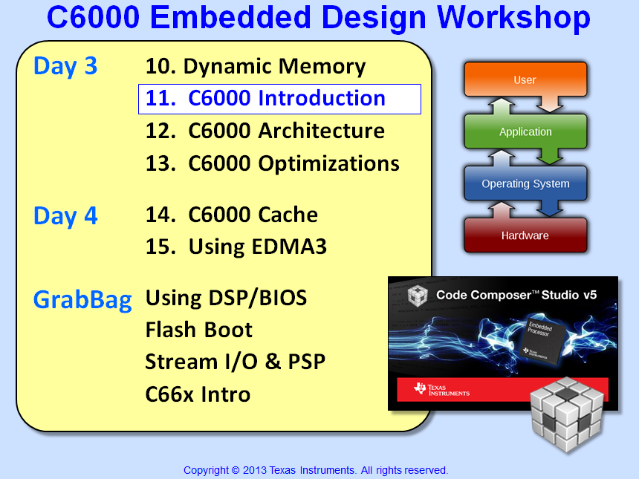

Slide 2
Objectives
Introduce the C6000 Core and the C6748 target device
Highlight a few uncommon pieces of the architecture – e.g. the SCR and PRU
“Catch up” from the TI-RTOS Kernel discussions are C6000-specific topics such as Interrupts, Platforms and Target Config Files
Lab 11 – Create a custom platform and create an Hwi to respond to the audio interrupts

Slide 3
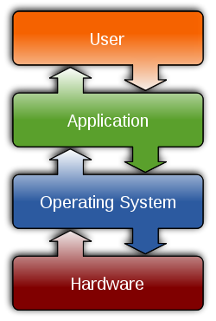
Outline
TI EP Product Portfolio
DSP Core
Devices & Documentation
Peripherals
Example Device: C6748 DSP
Choosing a Device
C6000 Arch “Catchup”
Quiz
Lab

Slide 4
TI’s Embedded Processor Portfolio
Microcontrollers (MCU) |  |  |  | Application (MPU)
MSP430 | C2000 | Tiva-C | Hercules | Sitara | DSP | Multicore
16-bit | 32-bit | 32-bit | 32-bit | 32-bit | 16/32-bit | 32-bit
Ultra Low Power & Cost | Real-time | All-around MCU | Safety | Linux Android | All-around DSP | Massive Performance
MSP430 ULP RISC MCU | Real-time C28x MCU ARM M3+C28 | ARM Cortex-M3 Cortex-M4F | ARM Cortex-M3 Cortex-R4 | ARM Cortex-A8 Cortex-A9 | DSP C5000 C6000 | C66 + C66 A15 + C66 A8 + C64 ARM9 + C674
Low Pwr Mode 0.1 µA 0.5 µA (RTC) Analog I/F RF430 | Motor Control Digital Power Precision Timers/PWM | 32-bit Float Nested Vector Int Ctrl (NVIC) Ethernet (MAC+PHY) | Lock step Dual-core R4 ECC Memory SIL3 Certified | $5 Linux CPU 3D Graphics PRU-ICSS industrial subsys | C5000 Low Power DSP 32-bit fix/float C6000 DSP | Fix or Float Up to 12 cores 4 A15 + 8 C66x DSP MMAC’s: 352,000
TI RTOS (SYS/BIOS) | TI RTOS (SYS/BIOS) | TI RTOS (SYS/BIOS) | N/A | Linux, Android, SYS/BIOS | C5x: DSP/BIOS C6x: SYS/BIOS | Linux SYS/BIOS
Flash: 512K FRAM: 64K | 512K Flash | 512K Flash | 256K to 3M Flash | L1: 32K x 2 L2: 256K | L1: 32K x 2 L2: 256K | L1: 32K x 2 L2: 1M + 4M
25 MHz | 300 MHz | 80 MHz | 220 MHz | 1.35 GHz | 800 MHz | 1.4 GHz
$0.25 to $9.00 | $1.85 to $20.00 | $1.00 to $8.00 | $5.00 to $30.00 | $5.00 to $25.00 | $2.00 to $25.00 | $30.00 to $225.00

Slide 5
Outline
TI EP Product Portfolio
DSP Core
Devices & Documentation
Peripherals
Example Device: C6748 DSP
Choosing a Device
C6000 Arch “Catchup”
Quiz
Lab

Slide 6
What Problem Are We Trying To Solve?
DSP
ADC
x
Y
DAC
Digital sampling of an analog signal:
Most DSP algorithms can be expressed with MAC:
count
A
Y = Σ coeff_{i} * x_{i}
i = 1
for (i = 0; i < count; i++){ Y += coeff[i] * x[i]; }
t
How is the architecture designed to maximize computations like this?
Notes:
Over the next 20 slides, we want to provide an example to anchor the presentation and provide context. What better algorithm than the standard sum-of products. The question lead-in is “so, what problem are we trying to solve?” “The basics of DSP involve first sampling an analog signal and converting it to digital. What do we do then? Some type of algorithm to shape, modify, etc the signal. This is easily done in the digital realm. So, the time between samples is our limit to how fast we need to do the algorithm. What’s a typical algorithm look like - this! A simple sum-of products. Let’s look at a typical DSP algorithm and see how the processor is designed to handle it.
Spend about 1 minute on this slide. If the group is VERY new to DSP, you might embellish slightly on any areas you feel comfortable with. But remember, the focus is not WHY DSP, it is “assuming you know why you’d want to use this algorithm, let’s see how the processor is built to handle it”.
The lead-into the next slide is the Q shown on the slide. Also state that we plan to write the code for this algorithm and see how the architecture is designed to handle it efficiently.
OLD INFO

Slide 7
'C6x CPU Architecture
Memory
‘C6x Compiler excels at Natural C
Multiplier (.M) and ALU (.L) provide up to 8 MACs/cycle (8x8 or 16x16)
Specialized instructions accelerate intensive, non-MAC oriented calculations. Examples include:
Video compression, Machine Vision, Reed Solomon, …
While MMACs speed math intensive algorithms, flexibility of 8 independent functional units allows the compiler to quickly perform other types of processing
‘C6x CPU can dispatch up to eight parallel instructions each cycle
All ‘C6x instructions are conditional allowing efficient hardware pipelining
A0
.D1
.D2
B0
.S1
.S2
MACs
.M1
.M2
. .
.L1
.L2
. .
A31
B31
Controller/Decoder
Note: More details later…

Slide 8
C6000 DSP Family CPU Roadmap
C66x
C674
C64x+
Fixed and Floating Point
Lower power
EDMA3
PRU
C64x
L1 RAM/Cache
Compact Instr’s
EDMA3
Fixed Point
Video/Imaging Enhanced
EDMA2
Available on the most recent releases
C621x
C67x+
C62x
C671x
Floating Point
C67x
Notes:
In the beginning, TI developed the C6000 architecture which was born as a C engine using a VLIW architecture. The C62x was the first fixed-point device in this family. Soon thereafter, the C67x was developed and included a floating-pt core that could perform both fixed and floating point operations. After that, the fixed point and floating point devices evolved separately until they finally merged with the latest core, the C674. The C66x devices are multi-core offering up to 8 cores per device.

Slide 9
C6000 DSP Family CPU Roadmap
1.2 GHz
EDMA3
SPLOOP
32x32 Int Multiply
Enhanced Instr for FIR/FFT/Complex
C66x
1GHz
EDMA (v2)
2x Register Set
SIMD Instr’s (Packed Data Proc)
C674
C64x+
Combined Instr Sets from C64x+/C67x+
Incr Floating-pt MHz
Lower power
EDMA3
PRU
C64x
L1 RAM and/or Cache
Timestamp Counter
Compact Instr’s
Exceptions
Supervisor/User modes
C621x
DMAX (PRU)
2x Register Set
FFT enhancements
EDMA
L1 Cache
L2 Cache/RAM
Lower Cost
C67x+
C62x
C671x
C67x

Slide 10
Outline
TI EP Product Portfolio
DSP Core
Devices & Documentation
Peripherals
Example Device: C6748 DSP
Choosing a Device
C6000 Arch “Catchup”
Quiz
Lab

Slide 11
DSP Generations : DSP and ARM+DSP
Fixed-Point Cores | Float-Point Cores | DSP | DSP+DSP (Multi-core) | ARM+DSP
C62x | C67x | C620x, C670x
C621x | C67x | C6211, C671x
C64x |  | C641x DM642
 | C67x+ | C672x
C64x+ |  | DM643x C645x | C647x | DM64xx, OMAP35x, DM37x
C674x |  | C6748 |  | OMAP-L138* C6A8168
C66x |  | Future | C667x C665x (new)
Notes:
* Of the current Integra/DaVinci parts, only the OMAP-L13x devices allow full access to the peripherals from the DSP – all others are limited. (Note, though, that the DM6446 has been tested for DSP peripheral access, but its datasheet is not written that way.

Slide 12
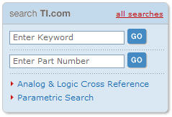
Key C6000 Manuals
 | C64x/C64x+ | C674 | C66x
CPU Instruction Set Ref Guide | SPRU732 | SPRUFE8 | SPRUGH7
Megamodule/Corepac Ref Guide | SPRU871 | SPRUFK5 | SPRUGW0
Peripherals Overview Ref Guide | SPRUE52 | SPRUFK9 | N/A
Cache User’s Guide | SPRU862 | SPRUG82 | SPRUGY8
Programmers Guide | SPRU198 |  | SPRA198 SPRAB27
DSP/BIOS Real-Time Operating System
SPRU423 - DSP/BIOS (v5) User’s Guide
SPRU403 - DSP/BIOS (v5) C6000 API Guide
SPRUEX3 - SYS/BIOS (v6) User’s Guide
Code Generation Tools
SPRU186 - Assembly Language Tools User’s Guide
SPRU187 - Optimizing C Compiler User’s Guide
To find a manual, at www.ti.com and enter the document number in the Keyword field:
or…
www.ti.com/lit/<litnum>
Notes:
We’ve included this list since we don’t ship ALL the books to every class. It was a waste of money and paper since so many were being left behind when students left the class.
Suggest they call the literature hotline (during break today, even) and request any books they want be delivered directly to their desk. It takes about a week.
Also, all the literature is available online via the TI website.
Finally, warn them that this list is constantly changing. They might find minor variations, especially the letter at the end of the literature number - which means that item’s been updated.

Slide 13
Outline
TI EP Product Portfolio
DSP Core
Devices & Documentation
Peripherals
PRU
SCR / EDMA3
Pin Muxing
Example Device: C6748 DSP
Choosing a Device
C6000 Arch “Catchup”
Quiz
Lab

Slide 14
ARM
Graphics
Accelerator
C6x DSP
Video Accelerator(s)
Peripherals
PRU
(Soft Peripheral)
Video/Display
Subsytem
Serial | Storage | Master | Timing
McBSP | DDR2 | PCIe | Timers
McASP | DDR3 | USB 2.0 | Watch
ASP | SDRAM | EMAC | PWM
UART | Async | uPP | eCAP
SPI | SD/MMC | HPI | RTC
I2C | ATA/CF | EDMA3
CAN | SATA | SCR | GPIO
CAN
Capture
UART
Analog
Display
What’s Next?
Digital
Display
DIY…
LCD
Controller
We’ll just look at three of these: PRU and SCR/EDMA3
Notes:
Between the enormity of examining the features of every one of these peripherals, and the fact that each device has a different subset of peripherals, we just don’t have the time to dig into each one of them.
The only one we’ll look at briefly is the PRU, which is probably not so self-explanatory.

Slide 15
Outline
TI EP Product Portfolio
DSP Core
Devices & Documentation
Peripherals
PRU
SCR / EDMA3
Pin Muxing
Example Device: C6748 DSP
Choosing a Device
C6000 Arch “Catchup”
Quiz
Lab

Slide 16
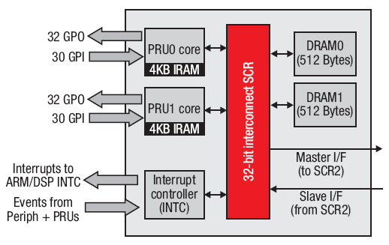
Programmable Realtime Unit (PRU)
PRU consists of:
2 Independent, Realtime RISC Cores
Access to pins (GPIO)
Its own interrupt controller
Access to memory (master via SCR)
Device power mgmt control (ARM/DSP clock gating)
Use as a soft peripheral to imple-ment add’l on-chip peripherals
Examples implementations include:
Soft UART
Soft CAN
Create custom peripherals or setup non-linear DMA moves.
No C compiler (ASM only)
Implement smart power controller:
Allows switching off both ARM and DSP clocks
Maximize power down time by evaluating system events before waking up DSP and/or ARM

Slide 17
PRU SubSystem : IS / IS-NOT
Is | Is­Not
Dual 32­bit RISC processor specifically designed for manipulation of packed memory mapped data structures and implementing system features that have tight real time constraints. | Is not a H/W accelerator used to speed up algorithm computations.
Simple RISC ISA: Approximately 40 instructions Logical, arithmetic, and flow control ops all complete in a single cycle | Is not a general purpose RISC processor: No multiply hardware/instructions No cache or pipeline No C programming
Simple tooling: Basic command­line assembler/linker | Is not integrated with CCS. Doesn’t include advanced debug options
Includes example code to demonstrate various features. Examples can be used as building blocks. | No Operating System or high-level application software stack

Slide 18
Outline
TI EP Product Portfolio
DSP Core
Devices & Documentation
Peripherals
PRU
SCR / EDMA3
Pin Muxing
Example Device: C6748 DSP
Choosing a Device
C6000 Arch “Catchup”
Quiz
Lab

Slide 19
System Architecture – SCR/EDMA
Switched Central Resource
“Masters”
“Slaves”
SCR – Switched Central Resource
Masters initiate accesses to/from slaves via the SCR
Most Masters (requestors) and Slaves (resources) have their own port to the SCR
Lower bandwidth masters (HPI, PCI66, etc) share a port
There is a default priority (0 to 7) to SCR resources that can be modified.
ARM
C64 Mem
DDR2
DSP
EMIF64
EDMA3
TCP
TC0
VCP
CC
TC1
TC2
PCI
McBSP
Note: this picture is the “general idea”. Every device has a different scheme for SCRs and peripheral muxing. In other words “check your data sheet”.
PCI
Utopia
HPI
EMAC
SCR
Notes:
If masters of the same priority access the same resource, they will share that resource in a round-robin fashion.

Slide 20
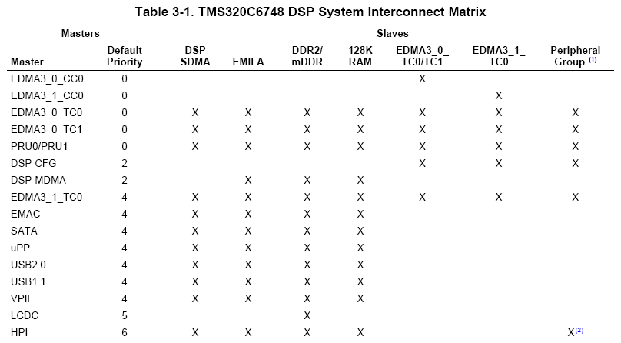
TMS320C6748 Interconnect Matrix
Note: not ALL connections are valid
Notes:
If masters of the same priority access the same resource, they will share that resource in a round-robin fashion.

Slide 21
Outline
TI EP Product Portfolio
DSP Core
Devices & Documentation
Peripherals
PRU
SCR / EDMA3
Pin Muxing
Example Device: C6748 DSP
Choosing a Device
C6000 Arch “Catchup”
Quiz
Lab

Slide 22
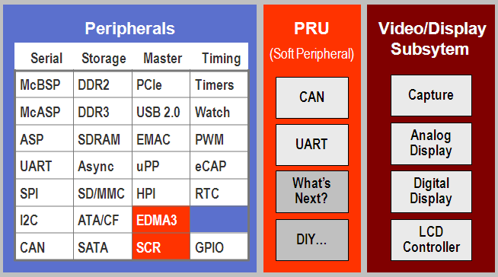
What is Pin Multiplexing?
Pin Mux Example
HPI
uPP
How many pins are on your device?
How many pins would all your peripheral require?
Pin Multiplexing is the answer – only so many peripherals can be used at the same time … in other words, to reduce costs, peripherals must share available pins
Which ones can you use simultaneously?
Designers examine app use cases when deciding best muxing layout
Read datasheet for final authority on how pins are muxed
Graphical utility can assist with figuring out pin-muxing…
Pin mux utility...

Slide 23
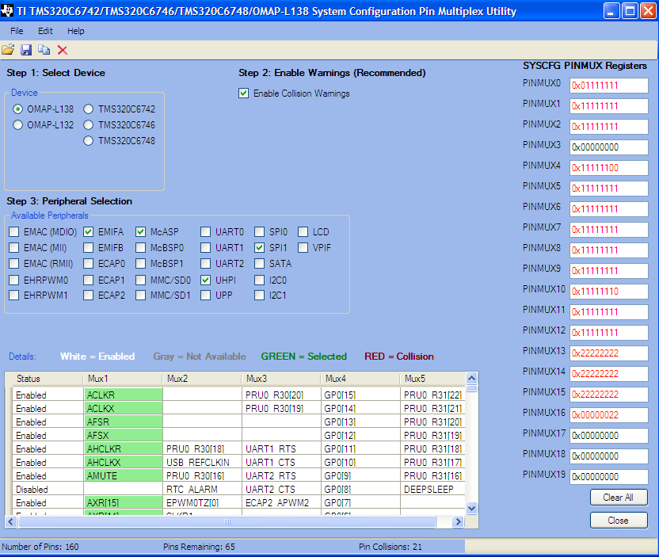
Pin Muxing Tools
Graphical Utilities For Determining which Peripherals can be Used Simultaneously
Provides Pin Mux Register Configurations. Warns user about conflicts.
ARM-based devices: www.ti.com/tool/pinmuxtool others: see product page

Slide 24
Outline
TI EP Product Portfolio
DSP Core
Devices & Documentation
Peripherals
Example Device: C6748 DSP
Choosing a Device
C6000 Arch “Catchup”
Quiz
Lab

Slide 25
TMS320C674x Architecture - Overview
TMS320C6748
Performance & Memory
128K L3
EDMA3
4-32x PLL
Up to 456MHz
256K L2 (cache/SRAM)
32K L1P/D Cache/SRAM
16-bit DDR2-266
16-bit EMIF (NAND Flash)
16-bit EMIF
128
32KB L1P Cache/SRAM
DDR2 mDDR
256K
L2
256
McASP
C674x+ DSP Core
Communications
Switched Central Resource (SCR)
64-Channel EDMA 3.0
10/100 EMAC
USB 1.1 & 2.0
SATA
Fixed & Floating-Pt
CPU
MMC/SD
EMAC
HPI
Power/Packaging
USB
128
SATA
13x13mm nPBGA & 16x16mm PBGA
Pin-to-pin compatible w/OMAP L138 (+ARM9), 361-pin pkg
Dynamic voltage/freq scaling
Total Power < 420mW
128
Timers
128
128
I2C, SPI, UART
LCD, PWM, eCAP
32KB L1D Cache/SRAM
uPP
Notes:
mDDR – mobile DDR

Slide 26
Outline
TI EP Product Portfolio
DSP Core
Devices & Documentation
Peripherals
Example Device: C6748 DSP
Choosing a Device
C6000 Arch “Catchup”
Quiz
Lab

Slide 27
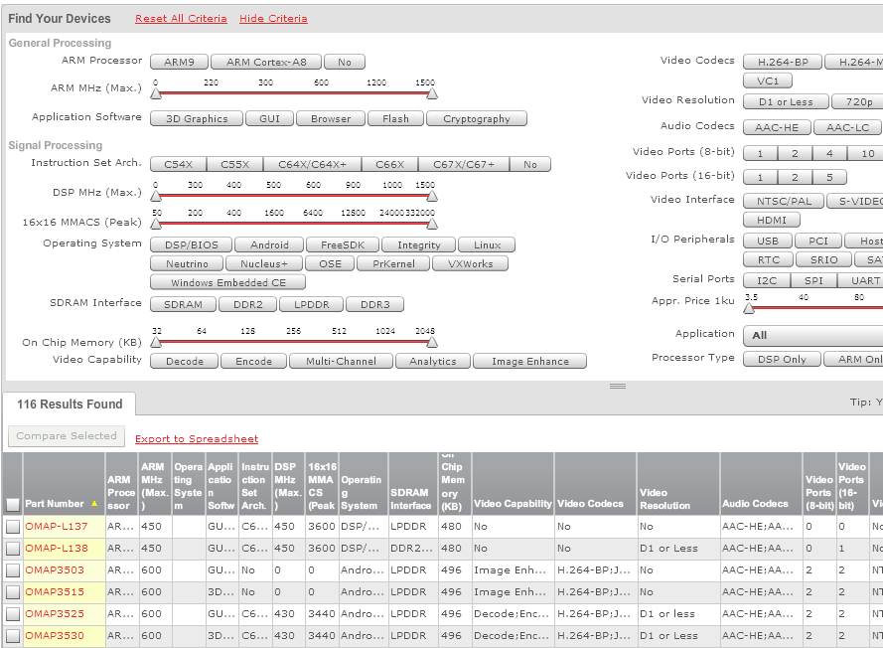
DSP & ARM MPU Selection Tool
http://focus.ti.com/en/multimedia/flash/selection_tools/dsp/dsp.html

Slide 28
Outline
TI EP Product Portfolio
DSP Core
Devices & Documentation
Peripherals
Example Device: C6748 DSP
Choosing a Device
C6000 Arch “Catchup”
C64x+ Interrupts
Event Combiner
Target Config Files
Creating Custom Platforms
Quiz
Lab

Slide 29
Outline
TI EP Product Portfolio
DSP Core
Devices & Documentation
Peripherals
Example Device: C6748 DSP
Choosing a Device
C6000 Arch “Catchup”
C64x+ Interrupts
Event Combiner
Target Config Files
Creating Custom Platforms
Quiz
Lab

Slide 30
How do Interrupts Work?
1. An interrupt occurs
2. Interrupt Selector
3. Sets flag in Interrupt Flag Register (IFR)
EDMA
McASP
Timer
Ext’l pins
124+4
12
…
4. Is this specific interrupt enabled? (IER)
5. Are interrupts globally enabled? (GIE/NMIE)
6.
CPU Acknowledge
Auto hardware sequence
HWI Dispatcher (vector)
Branch to ISR
7. Interrupt Service Routine (ISR)
Context Save, ISR, Context Restore
User is responsible for setting up the following:
#2 – Interrupt Selector (choose which 12 of 128 interrupt sources to use)
#4 – Interrupt Enable Register (IER) – individually enable the proper interrupt sources
#5 – Global Interrupt Enable (GIE/NMIE) – globally enable all interrupts
Notes:
128 total events which is 124 events + 4 from the event combiner (covered also).
There are actually 16 core interrupts, not 12. But only 12 can be user-configured. The other 4 are RESET, NMI and two emulator interrupts. These are interrupts 0-3. 4-15 are user interrupts.
NMIE also must be enabled. I know, a maskable non-maskable interrupt. Once NMIE is turned on, it can never be turned off. If using BIOS, NMIE/GIE are handled automatically. However, if BIOS is NOT used, these steps must be handled by the user.

Slide 31
C64x+ Hardware Interrupts
Interrupt Selector
IFR
IER
GIE
0
. .
HWI₄
MCASP0_INT
0
Vector
Table
HWI₅
1
. . .
. .
HWI₁₅
127
0
1
2
3
4
C6748 has 128 possible interrupt sources (but only 12 CPU interrupts)
4-Step Programming:
Interrupt Selector – choose which of the 128 sources are tied to the 12 CPU ints
IER – enable the individual interrupts that you want to “listen to” (in BIOS .cfg)
GIE – enable global interrupts (turned on automatically if BIOS is used)
Note: HWI Dispatcher performs “smart” context save/restore (automatic for BIOS Hwi)
Note: NMIE must also be enabled. BIOS automatically sets NMIE=1. If BIOS is NOT used, the user must turn on both GIE and NMIE manually.
Notes:
Uint32 gie;
…
gie = IRQ_globalDisable();
...
IRQ_globalRestore(gie);
Also, if NMIE is not enabled, NO interrupts will occur.

Slide 32
Outline
TI EP Product Portfolio
DSP Core
Devices & Documentation
Peripherals
Example Device: C6748 DSP
Choosing a Device
C6000 Arch “Catchup”
C64x+ Interrupts
Event Combiner
Target Config Files
Creating Custom Platforms
Quiz
Lab

Slide 33
Event Combiner (ECM)
Use only if you need more than 12 interrupt events
ECM combines multiple events (e.g. 4-31) into one event (e.g. EVT0)
EVTx ISR must parse MEVTFLAG to determine which event occurred
Occur?
Care?
Both Yes?
Interrupt Selector
EVTFLAG[0]
EVTMASK[0]
MEVTFLAG[0]
EVT 4-31
EVT0
EVTFLAG[1]
EVTMASK[1]
MEVTFLAG[1]
EVT 32-63
EVT1
C P U
EVTFLAG[2]
EVTMASK[2]
MEVTFLAG[2]
EVT 64-95
EVT2
128:12
EVTFLAG[3]
EVTMASK[3]
MEVTFLAG[3]
EVT 96-127
EVT3
EVT 4-127
Notes:
Can combine external interrupts. So, assume that 2 pieces of h/w are connected, but you don’t want to do anything until BOTH interrupts occur. User ISR can wait for both vs. either/or.
EVTFLAG[3:0] captures the fact that an event occurred. The user can mask an event from getting to the EVTx via the EVTMASK. If an event occurs that is NOT masked, it is flagged in the MEVTFLAG[3:0] register. All events (like 4-31) are ORed together to cause EVT0. The ISR, if for example EVT0 occurs, could then look at the MEVTFLAG[x] register and determine which bits were set – then take the appropriate action. Each register shown above (EVTFLAG, EVTMASK, MEVTFLAG) are all 32-bit registers.

Slide 34
Outline
TI EP Product Portfolio
DSP Core
Devices & Documentation
Peripherals
Example Device: C6748 DSP
Choosing a Device
C6000 Arch “Catchup”
C64x+ Interrupts
Event Combiner
Target Config Files
Creating Custom Platforms
Quiz
Lab

Slide 35
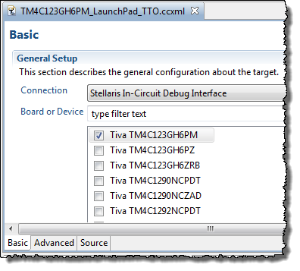
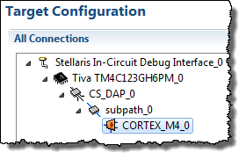
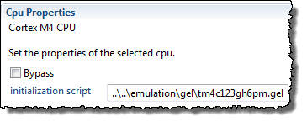
Creating a New Target Config File (.ccxml)
Target Configuration – defines your “target” – i.e. emulator/device used, GEL scripts (replaces the old CCS Setup)
Create user-defined configurations (select based on chosen board)
Advanced Tab
“click”
Specify GEL script here
More on GEL files...

Slide 36
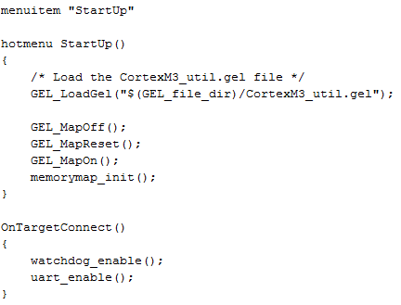
What is a GEL File ?
GEL – General Extension Language (not much help, but there you go…)
A GEL file is basically a “batch file” that sets up the CCS debug environment including:
Memory Map
Watchdog
UART
Other periphs
The board manufacturer (e.g. SD or LogicPD) supplies GEL files with each board.
To create a “stand-alone” or “bootable” system, the user must write code to perform these actions (optional chapter covers these details)

Slide 37
Outline
TI EP Product Portfolio
DSP Core
Devices & Documentation
Peripherals
Example Device: C6748 DSP
Choosing a Device
C6000 Arch “Catchup”
C64x+ Interrupts
Event Combiner
Target Config Files
Creating Custom Platforms
Quiz
Lab

Slide 38
Creating Custom Platforms - Procedure
Most users will want to create their own custom platform package (Stellaris/c28X – maybe not – they will use a .cmd file directly)
Here is the process:
Create a new platform package
Select repository, add to project path, select device
Import the existing “seed” platform
Modify settings
[Save] – creates a custom platform pkg
Build Options – select new custom platform
Notes:
The idea of using a platform was to centralize all memory configurations into one place vs. having TCF files spread out all over the place.

Slide 39

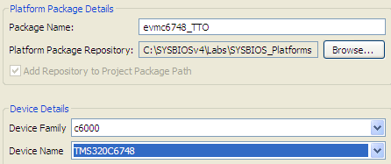
Creating Custom Platforms - Procedure
1
Create New Platform (via DEBUG perspective)
2
Configure New Platform
Platform Package Name
Custom Repository vs. XDC default location
“Add Repository to Path” – adds platform path to project path

Slide 40
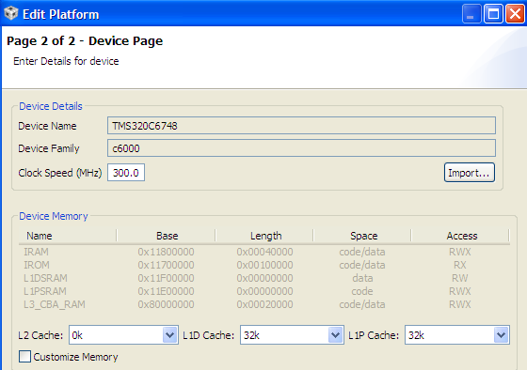
Creating Custom Platforms - Procedure
3
New Device Page – Click “Import” (copy “seed” platform)
4
Customize Settings

Slide 41
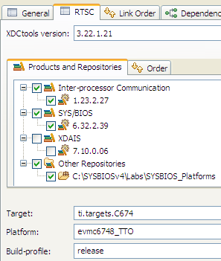
Creating Custom Platforms - Procedure
5
[SAVE] New Platform (creates custom platform package)
6
Select New Platform in Build Options (RTSC tab)
Custom Repository vs. XDC default location
With path added, the tools find new platform

Slide 42
Outline
TI EP Product Portfolio
DSP Core
Devices & Documentation
Peripherals
Example Device: C6748 DSP
Choosing a Device
C6000 Arch “Catchup”
Quiz
Lab

Slide 43
Chapter Quiz
How many functional units does the C6000 CPU have?
What is the size of a C6000 instruction word?
What is the name of the main “bus arbiter” in the architecture?
What is the main difference between a bus “master” and “slave”?
Fill in the names of the following blocks of memory and bus:
256
CPU
128

Slide 44
Chapter Quiz
How many functional units does the C6000 CPU have?
What is the size of a C6000 instruction word?
What is the name of the main “bus arbiter” in the architecture?
What is the main difference between a bus “master” and “slave”?
Fill in the names of the following blocks of memory and bus:
8 functional units or “execution units”
256 bits (8 units x 32-bit instructions per unit)
Switched Central Resource (SCR)
Masters can initiate a memory transfer (e.g. EDMA, CPU…)
L1P
S
C
R
256
L2
CPU
128
L1D

Slide 45
Outline
TI EP Product Portfolio
DSP Core
Devices & Documentation
Peripherals
Example Device: C6748 DSP
Choosing a Device
C6000 Arch “Catchup”
Quiz
Lab

Slide 46
Single vs Double Buffer Systems
Single buffer system: collect data or process data – not both!
Hwi
Swi/Task
Hwi
Swi/Task
BUF
BUF
Nowhere to store new data when prior data is being processed
Double buffer system: process and collect data – real-time compliant!
Hwi
Swi/Task
Hwi
Swi/Task
BUF y
BUF x
BUF x
BUF y
One buffer can be processed while another is being collected
When Swi/Task finishes buffer, it is returned to Hwi
Task is now ‘caught up’ and meeting real-time expectations
Hwi must have priority over Swi/Task to get new data while prior data is being processed – standard in SYS/BIOS

Slide 47
Lab 11 – Hwi Audio
Double Buffers
mcasp.c
isr.c
aic3106.c
isrAudio
rcvPing
Audio Input (48 KHz)
McASP XBUF12
datIn = XBUF12
pIn[cnt] = datIn
datOut = pOut[cnt]
XBUF11 = datOut
if (cnt >= BUF){
Copy RCV→XMT
}
ADC AIC3106
Audio Output (48 KHz)
McASP XBUF11
xmtPing
DAC AIC3106
Hwi
Procedure
COPY
RCV XMT
Import existing project (Lab11)
Create your own CUSTOM PLATFORM
Config Hwi to respond to McASP interrupt
Debug Interrupt Problems
Time = 45min
Notes:
(Recommend to the students that they treat the lab sessions as breaks, since each chapter has a lab at the end of it)

Slide 48


Slide 49
Outline
MainHighlight
MainNormal
SubHighlight
SubNormal

